Slide 1
Algorithm for Messenger Services Problem
SP 3

Slide 2

Introduction
Notes:
Bangkok

Slide 3

Notes:
Companies in BKK

Slide 4
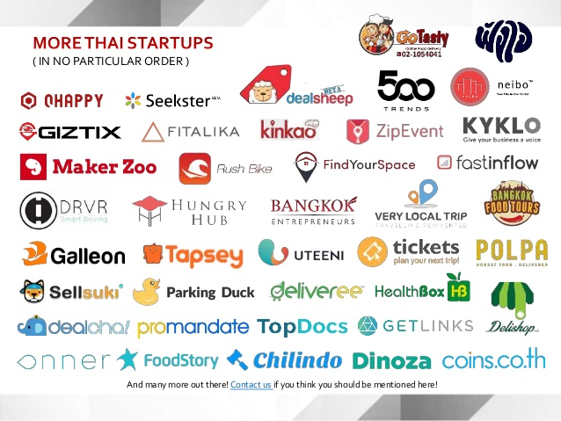
Notes:
Start-ups

Slide 5






Notes:
Messenger Services

Slide 6
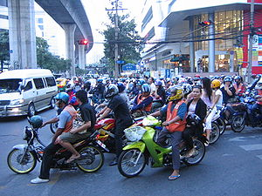
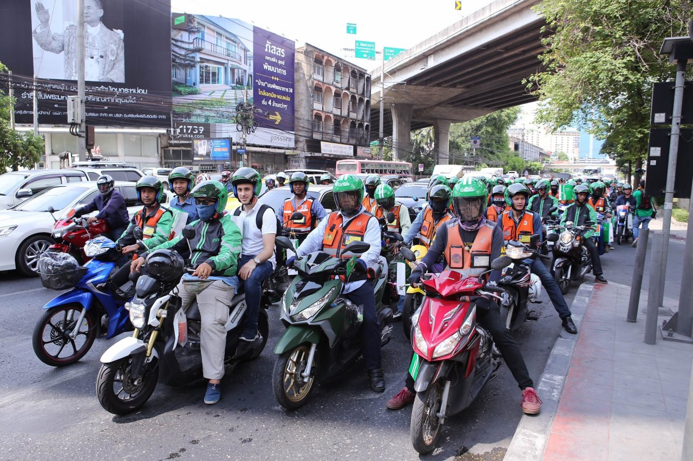
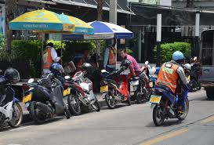
Notes:
Bike Taxis

Slide 7
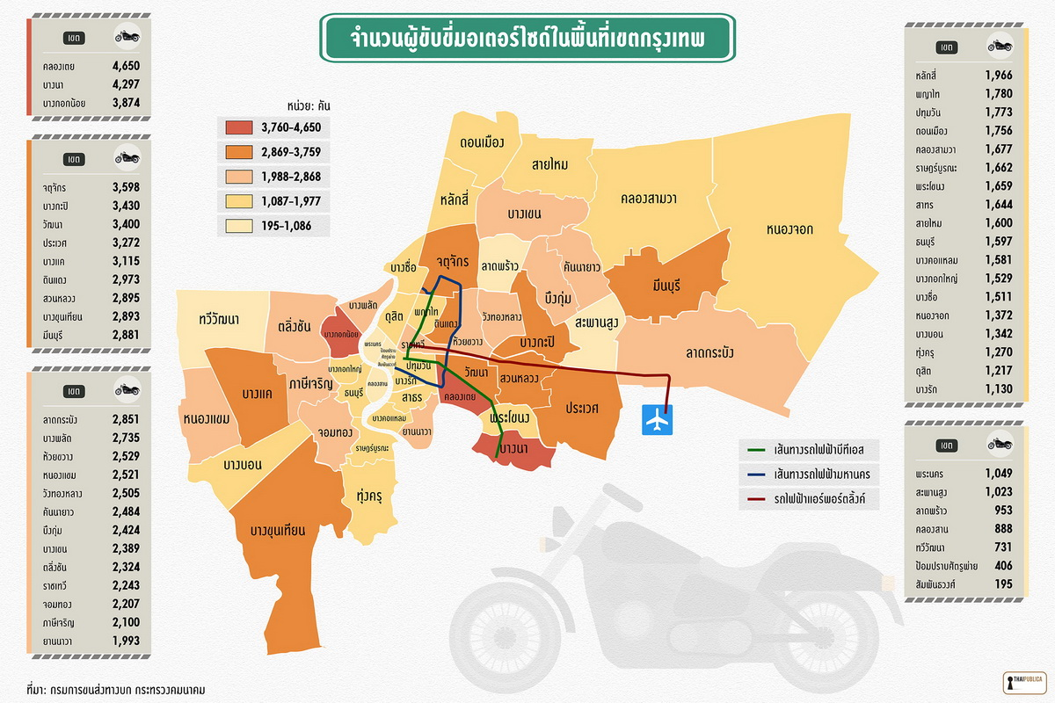
Pictures from :https://thaipublica.org/2016/06/bangkokpublica-3/
Notes:
Number of motorcycles

Slide 8
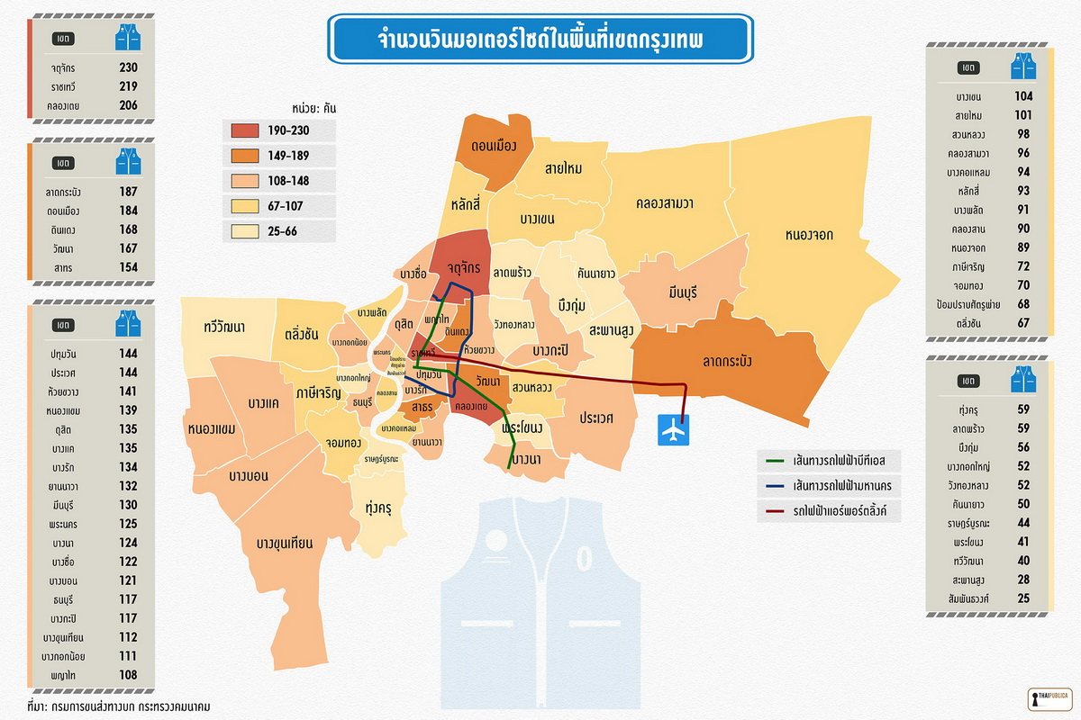
Pictures from :https://thaipublica.org/2016/06/bangkokpublica-3/
Notes:
Number of depots

Slide 9
Our System
Delivery Men can be anyone (but mostly ‘Bike Taxis’).
Assume that delivery men tends to go back to their depots
Generates jobs of routes
One job can serve multiple requests.
Focus on the ‘Documents’ messenger services (no load capacity constraints)

Slide 10
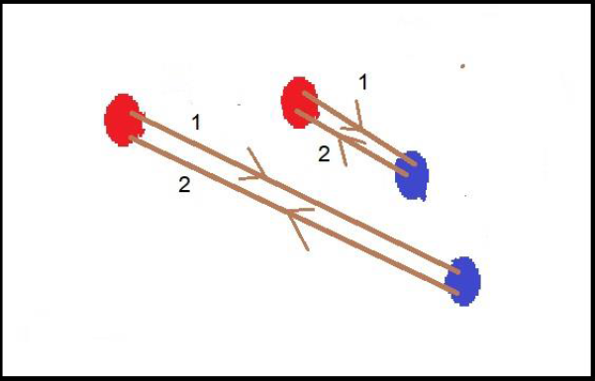
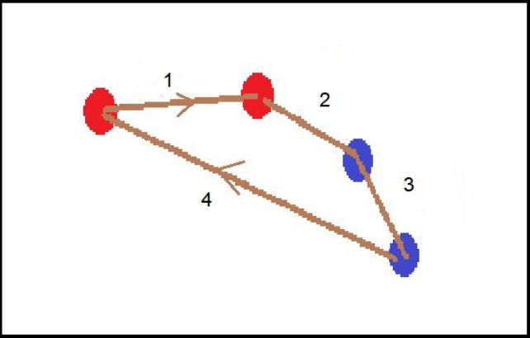
2 jobs for 2 routes
1 job for 2 routes

Slide 11
Deliverables
ALGORITHM

Slide 12
Process
Research and Explore
Run simulation tests
Develop the algorithms
Final report
First Semester |  |  |  | Second Semester

Slide 13
Pickup and Delivery Problem (PDP)
Vehicle Routing Problem (VRP)
Traveling Salesman Problem (TSP)

Slide 14
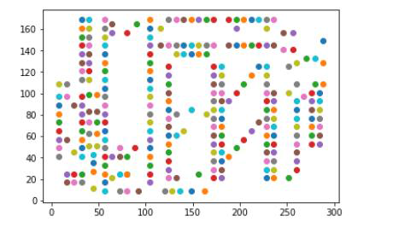
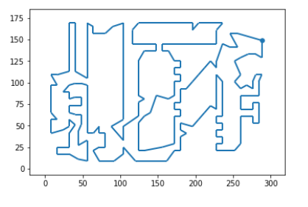
Traveling Salesman (TSP)
Notes:
In our project we will visualize them like this.

Slide 15
TSP vs VRP vs PDP
Only one vehicle (salesman)
Visit all nodes
Multiple vehicles
Visit all nodes
VRP with precedence constraints
TSP | VRP | PDP

Slide 16
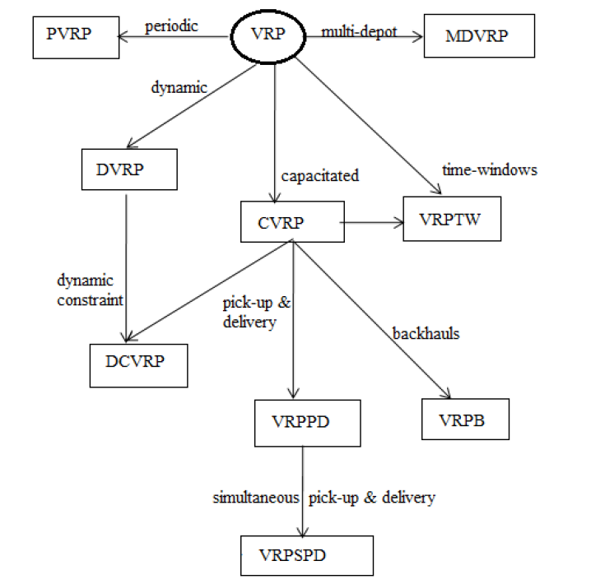
Pic from : Jyoti Gupta, Chander Diwaker (2015). Vehicle Routing Problem using Swarm Optimization Techniques.
Notes:
Variations

Slide 17


Constraints of our problem
Multi-Vehicles
Infinite numbers of vehicles
All requests have to be done
Precedence
Time-windows
No depots, but each vehicle has to return to the first pickup point
Goal: Minimize the total travel DISTANCES!!

Slide 18
Constraints of our problem (con.t)
Euclidean distances for test instances, Real distances for real maps
No load capacities
No service times
No load capacities
No service times
Maximum distance limit of a vehicle
Static requests
Goal: Minimize the total travel DISTANCES!!

Slide 19
Literature Review
Variations of VRP
Algorithms
For more details, read the proposal report.

Slide 20
Objectives are different and can be more than one
PDP/VRP
Capacitated
Single/Multi Vehicles
Single/Multi Depots
Static/Dynamic requests
Time windows?
Variations of VRP

Slide 21
Branch and price and cut, and bound (tends to be slow)
Genetic algorithm (GA)
Ant Colony Optimization (ACO)
Particle Swarm Optimization (PSO)
Local Search (LS), Variable neighborhood search (VNS)
Hybrids
Algorithms

Slide 22
Evaluations
Run Benchmark Test Instances
Compare non-combined solutions with the combined solutions
Simulate test Instances with real distances (using Google Maps API)

Slide 23
The Test Instances
Haibing Li and Andrew Lim
Cordeua
Instances must be modified.
Results cannot be directly compared.

Slide 24
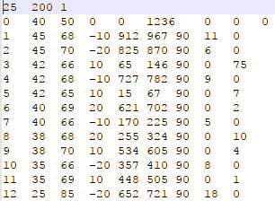
Li and Lim’s Instances

Slide 25
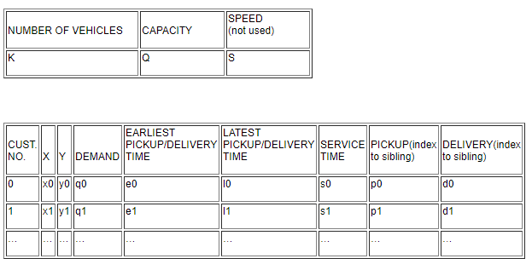
Li and Lim’s Instances

Slide 26
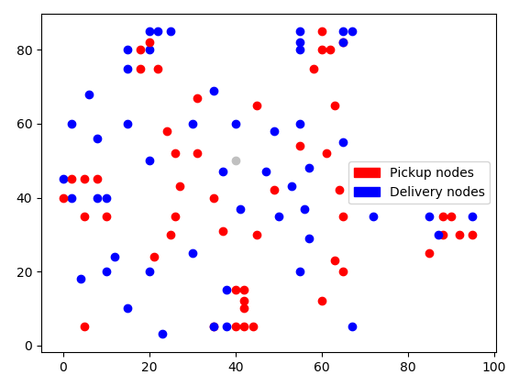
Li and Lim’s Instances
100 nodes

Slide 27
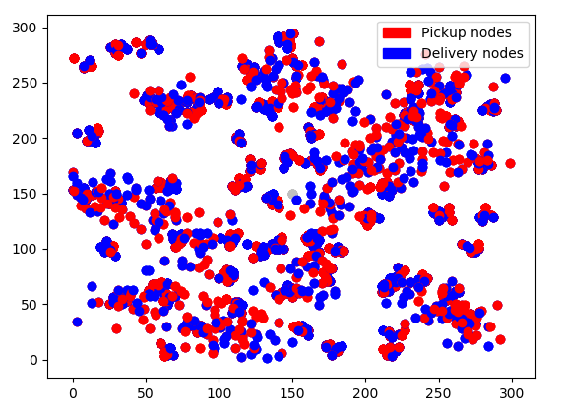
Li and Lim’s Instances
600 nodes

Slide 28
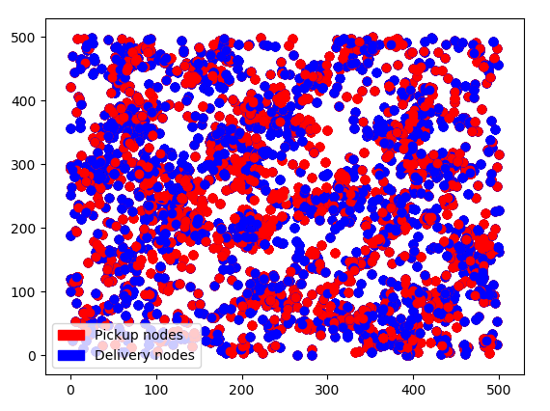
Li and Lim’s Instances
1000 nodes

Slide 29
After the benchmark?
REAL PLACES
AND
REAL DISTANCES?

Slide 30

Google Maps API

Slide 31
Google Maps API
Get coordinates of places
Get directions
Get distance between places
And much more. (out of scope)
We can make our own test cases using real places and real distances!!!

Slide 32
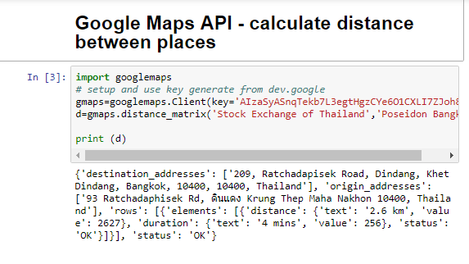

Slide 33
Process
Research and Explore
Run simulation tests
Develop the algorithms
Final report
First Semester |  |  |  | Second Semester

Slide 34
Any Question?

